Slide 1
ME759 High Performance Computing for Applications in Engineering [Spring 2020]
Lecture 03
01/27/2019
Dan Negrut, 2020 ME759 UW-Madison

Slide 2
Quote of the day
“Nothing is particularly hard if you divide it into small jobs.”
-- Henry Ford, American industrialist and a business magnate, founder of the Ford Motor Company [1863 – 1947]

Slide 3
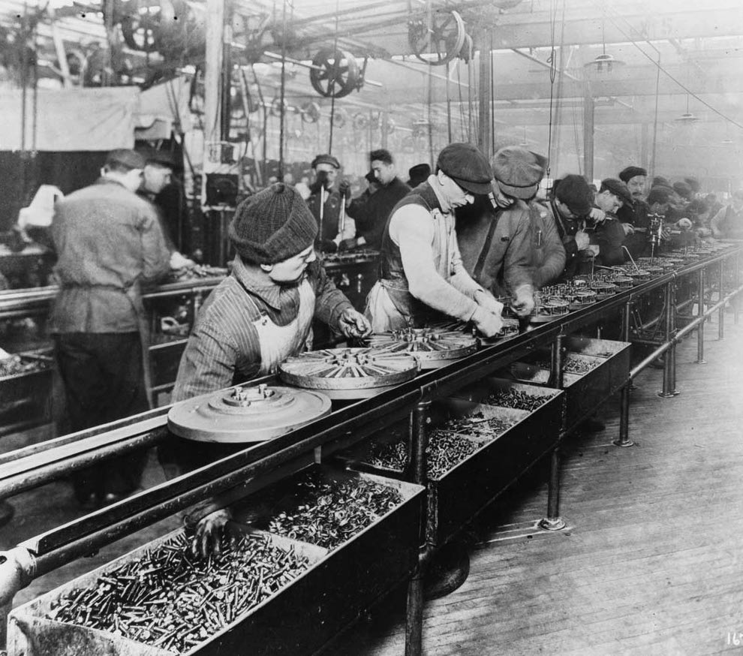
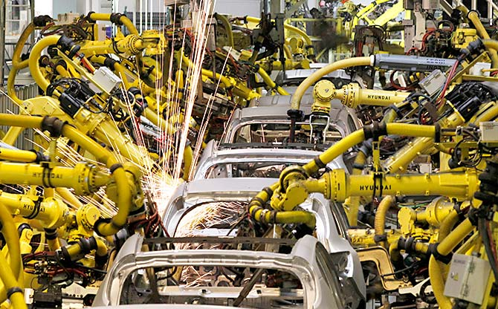
Pictures of the Day
Workers on the first moving assembly line put together magnetos and flywheels for 1913 Ford autos. Highland Park, Michigan
https://www.rediff.com/business/report/hyundai-uses-580-robots-in-chennai-plant-maruti-5000/20180530.htm
http://www.gpschools.org/ci/depts/eng/k5/third/fordpic.htm

Slide 4
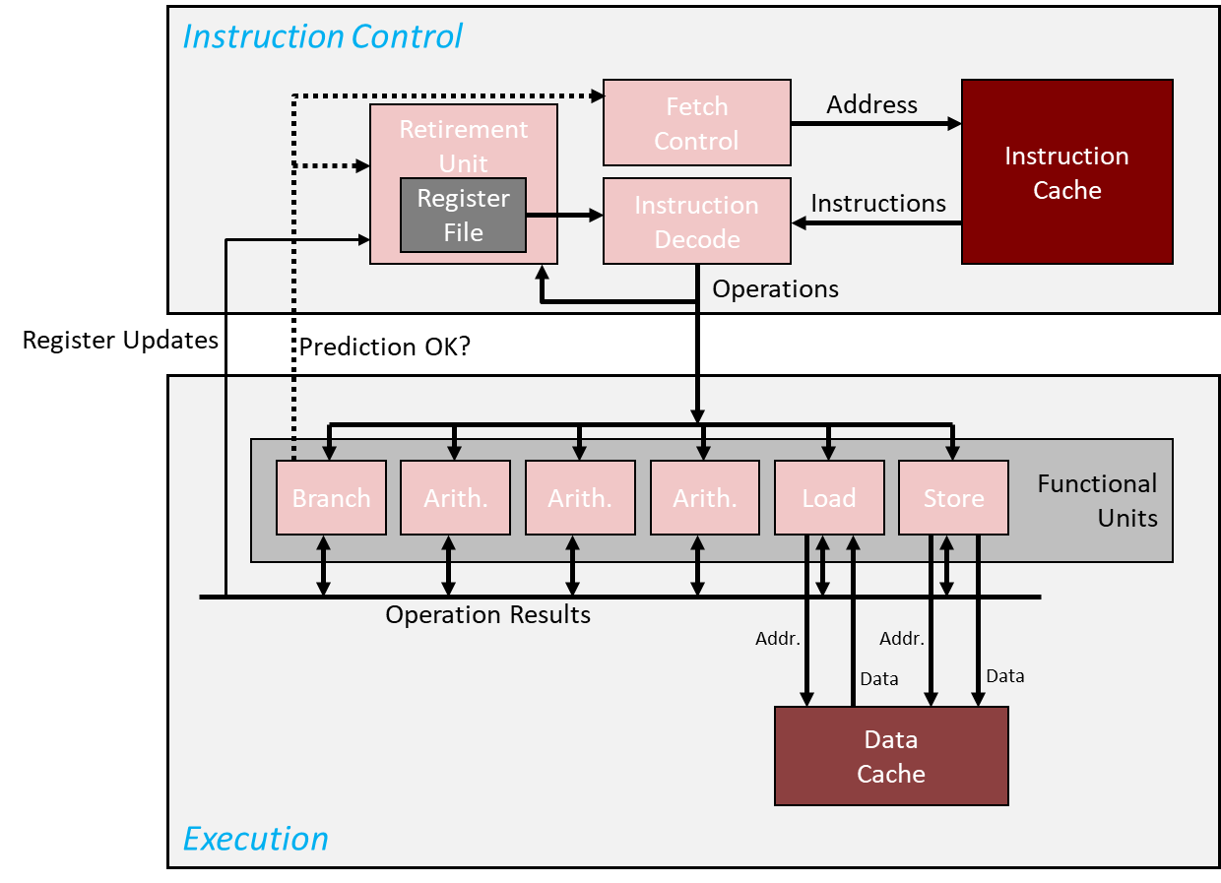
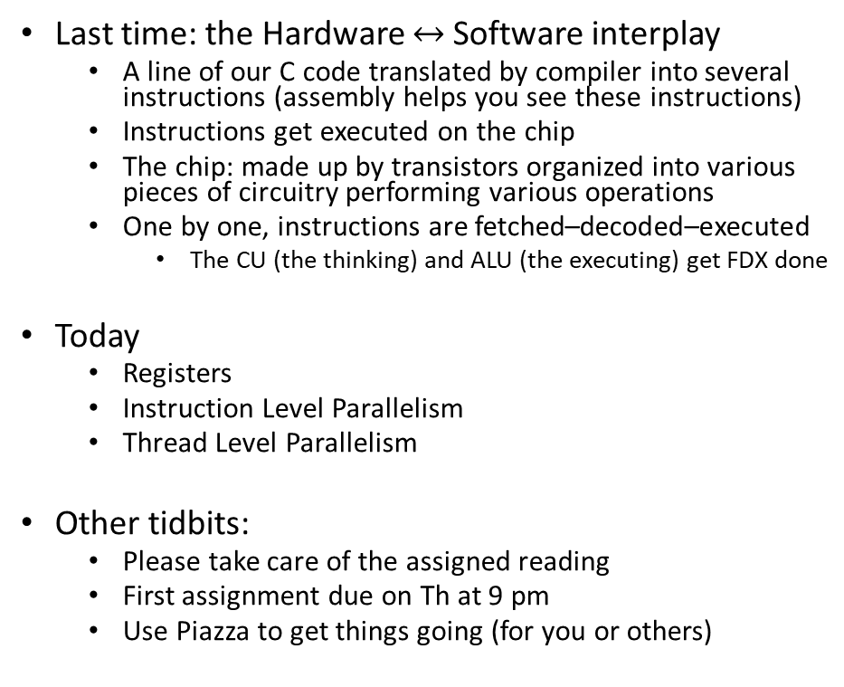
Before we get going…
Last time: the Hardware $↔$ Software interplay
A line of our C code translated by compiler into several instructions (assembly helps you see these instructions)
Instructions get executed on the chip
The chip: made up by transistors organized into various pieces of circuitry performing various operations
One by one, instructions are fetched–decoded–executed
The CU (the thinking) and ALU (the executing) get FDX done
Today
Registers
Instruction Level Parallelism
Thread Level Parallelism
Other tidbits:
Please take care of the assigned reading
First assignment due on Th at 9 pm
Use Piazza to get things going (for you or others)
Keep this pic in mind when you visualize how your code gets executed, instruction by instruction

Slide 5
Registers

Slide 6
Revisiting an older slide, to get us going
Line of C code:
a[4] = delta + a[3]; //line of C code
MIPS assembly code generated by the compiler (three instructions):
lw $t0, 12($s2) # reg $t0 gets value stored 12 bytes from address in $s2
add $t0, $s4, $t0 # reg $t0 gets the sum of values stored in reg $s4 and reg $t0
sw $t0, 16($s2) # store what’s in $t0 at mem location 16 bytes from address in $s2
Set of three corresponding MIPS instructions produced by the compiler:
10001110010010000000000000001100
00000010100010000100000000100000
10101110010010000000000000010000
Notes:
Typically, a line of code maps into more (some time many) instructions.
Once the instructions are encoded into machine code, they are indistinguishable from data (it’s only location in memory that can differentiate between data and instructions)

Slide 7
Registers, backdrop (1/2)
Instruction cycle: fetch-decode-execute (FDX)
CU – responsible for controlling the process that will deliver the request baked into the instruction
ALU – does the busy work to fulfill the request put forward by the instruction
The instruction that is being executed needs to be stored somewhere
Fulfilling the requests baked into an instruction usually involves input values and generates output values
This data needs to be stored somewhere
Notes:
“Stored somewhere” → in registers

Slide 8
Registers, backdrop (2/2)
Registers, quick facts:
A register is an entity whose role is that of storing information
A register is the storage type with shortest latency – it’s closest to the CU & ALU
Latency – can be of the order of hundreds of picoseconds
The number and size of registers used are specific to an ISA
The microarchitecture has to implement support per ISA’s specifications
Example: Back in the day, for the MIPS ISA, there were 32 registers of 32 bits (no more, no less)
Notes:
Typically, an n-bit register might require 4n … 8n transistors
Note: MIPS64 also uses 32 registers
Don’t expect to see too many registers: precious commodities which are located on prime real-estate

Slide 9
Register Types (1/4)
Discussion herein covers only several register types typically encountered in a CPU (abbreviation in parenthesis)
List not comprehensive, showing only the more important ones
Instruction Register (IR) – holds the instruction that is executed
Sometimes known as “current instruction register” CIR
Program Counter (PC) – holds address of the instruction executed next
NOTE: unlike IR, PC contains *address* of the instruction, not actual instruction
Notes:
An utility that monitors the program counter can tell you what the hot spots of your executable are
PC is used by profilers to see which instructions are hot-spots

Slide 10
Register Types (2/4)
Memory Data Register (MDR) – holds data read in from memory or, alternatively, produced by the ALU and waiting to be stored in memory
Memory Address Register (MAR) – holds address of RAM memory location where input/output data is supposed to be read in/written out
NOTE: unlike MDR, MAR contains *address* of a mem location, not actual data
Return Address (RA) – the address where upon finishing a sequence of instructions, the execution should jump and commence with the execution of subsequent instruction
Notes:
Other typical registers:
AC (accumulator): typically resides in the ALU

Slide 11
Register Types (3/4)
Registers on previous two slides are a staple in most ISA
There are several other registers common to many chip designs
These are encountered in different numbers (also depending on ISA)
Since they come in larger numbers they don’t have an acronym
Registers for Subroutine Arguments (4) – a0 through a3
Registers for Temporary Variables (10) – t0 through t9
Registers for Saved Temporary Variables (8) – s0 through s7
Saved between function calls
Notes:
Side-note: here’s where the “common wisdom” of having fewer subroutine arguments comes from: there are only 4 registers to store them. When more, additional manipulations.

Slide 12
Register Types (4/4)
Several other registers are involved in handling function calls
Summarized below, their meaning only apparent in conjunction with the organization of the virtual memory
Stack Pointer (sp) – a register that holds an address that points to the top of the stack
Global Pointer (gp) – a register that holds an address that points to the middle of a block of memory in the static data segment
Frame Pointer (fp) - a register that holds an address that points to the beginning of the procedure frame (for instance, the previous sp before this function changed its value)
Notes:
Virtual memory – at the end of this segment

Slide 13
Register, Departing Thoughts
Registers: a very precious resource
If they are so good, why can’t we have more?
Increasing their number is not straightforward
Need to change the design of the chip (the microarchitecture) & not enough space (maybe go 3D?)
Need to change the very nature of an instruction (and as such ISA gets touched in the process)
Examples:
In 32-bit MIPS ISA, there are 32 registers
GP100 GPU (Pascal): 56 SMs, each with 64 SPs. Total register file: 14336K (~3.5 million registers)
Seems impressive but it’s not: 56 SMs * 2048 threads/SM * 32 registers/thread (guesstimate) = 3.6 million registers needed
Notes:
We will see why so many registers on a GPU (don’t read too much into it right now)
Pascal: up to 2048 resident threads/SM → they all need registers
There’s a maximum of 255 registers/thread limit

Slide 14
Registers, take home message
When processing one instruction, the chip needs all instruction-related data in registers
Fallout, from above statement
You might have GBs of data to process. To be processed, this data will have to find its way in registers
We’ll talk about this data journey into registers later

Slide 15
Pipelining
“Nothing is particularly hard if you divide it into small jobs.”
Henry Ford

Slide 16
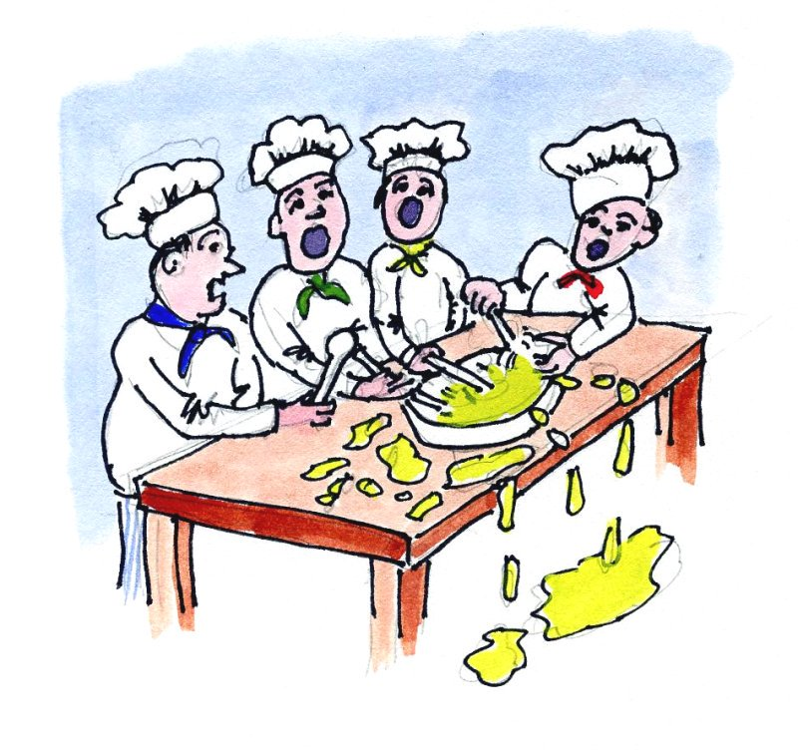
Comic of the day: Too many cooks spoil the broth.
[https://t.co/kYI3Mz1iKF]$→$

Slide 17
Workers on the first moving assembly line put together magnetos and flywheels for 1913 Ford autos. Highland Park, Michigan
http://www.gpschools.org/ci/depts/eng/k5/third/fordpic.htm [public domain]

Slide 18
Pipelining, or the Assembly Line Concept
Henry Ford: capitalized on, and improved the assembly line idea on an industrial scale and in the process shaped the automotive industry (Ford Model T)
Vehicle assembly line: a good example of a pipelined process
The output of one stage (station) becomes the input for the downstream stage
Once assembly line primed, a vehicle gets finished/manufactured during each cycle
“cycle” is the time it takes from the moment a station gets its input to the moment its output leaves the station

Slide 19
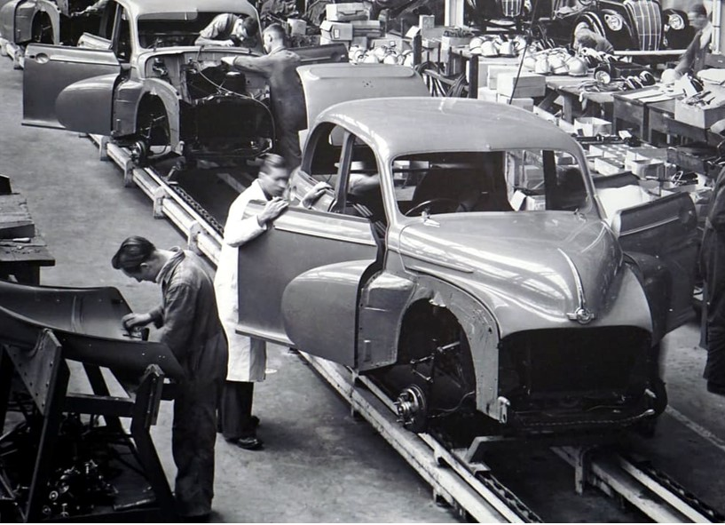
https://www.rediff.com/business/report/hyundai-uses-580-robots-in-chennai-plant-maruti-5000/20180530.htm
Historical change of the manufacturing line. Manual assembly line (left); Hyundai assembly line in Chennai, India (right)
Steve Jurvetson and Mike Bird [Creative Commons Attribution-Share Alike 4.0 International]$→$

Slide 20
Leaving Car Analogy Behind…
FDX cycle: Fetch, Decode, Execute - carried out for each machine instruction
Sometimes called FDXW (W: “Write”)
A closer look at what gets fetched (instructions and data) and then what happens upon execution leads to a generic five-stage process associated with an instruction
“generic” above means that, in a first order approximation, these five stages can represent any instruction, although some instructions might not have all five stages:
Stage 1: Fetch an instruction
Stage 2: Decode the instruction
Stage 3: Data access
Stage 4: Execute the operation (e.g., might be a request to calculate an address)
Stage 5: Write-back into register file
[Patterson, 4th edition]→
Notes:
Modern CPU pipelines are 14-19 deep

Slide 21
Rules of thumb: costs to execute an operation > 1 cycle [refers to older MIPS ISA; cost of X in FDX]
Four cycles for SW
Five cycles for LW
Four cycles for add
Etc.
21
Notes:
The numbers for the X86 family of chips is usually different

Slide 22
Pipelining, the basics
Assume a five-stage pipeline
Pipelining, cornerstone idea: the following tasks can be worked upon simultaneously when processing five instructions:
Instruction 1 is in the 5th stage of the FDX cycle
Instruction 2 is in the 4th stage of the FDX cycle
Instruction 3 is in the 3rd stage of the FDX cycle
Instruction 4 is in the 2nd stage of the FDX cycle
Instruction 5 is in the 1st stage of the FDX cycle
Notes:
Balance issue:
For the simple 5-stage RISC pipeline discussed here, this is mostly true:
register read/write ~100 ns
fetch/ALU/data read ~200 ns
Modern processor: deep pipelines, because instructions are further broken down to be comparable in time

Slide 23
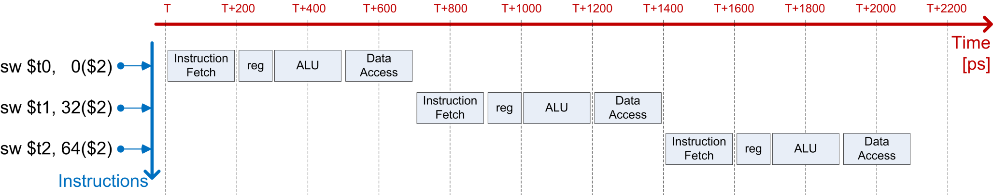
Example: Streaming for execution 3 SW instructions
sw $t0, 0($s2)
sw $t1, 32($s2)
sw $t2, 64($s2)
Case 1: No pipelining – 2100 picoseconds [ps]
Notes:
sw: in MIPS means ‘store word’
ALU used to add offset
sw: no data access needed (missing stage 3)
sw $t0, 32($s2) # store what’s in $t0 at mem location bytes from address in $s2

Slide 24
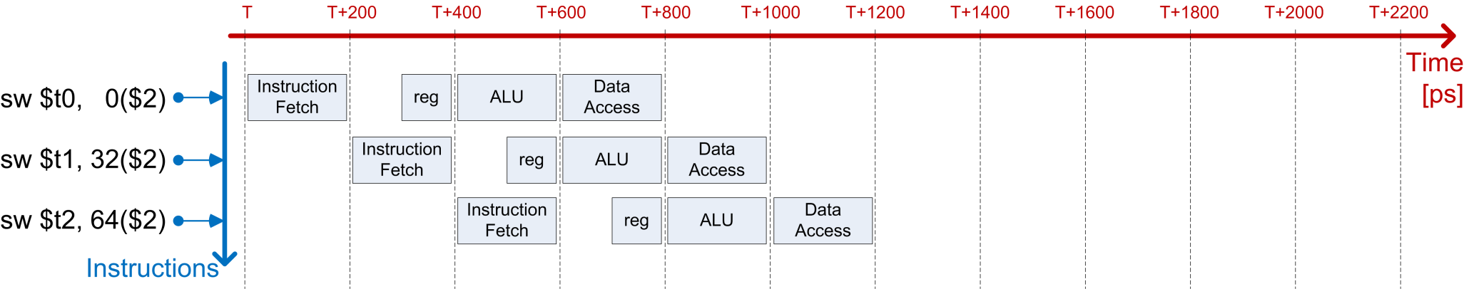
Example: Streaming for execution 3 SW instructions
sw $t0, 0($s2)
sw $t1, 32($s2)
sw $t2, 64($s2)
Case 2: With pipelining – 1200 picoseconds [ps] (5 GHz clock cycle)
Notes:
Pipelining in use since the 1990s

Slide 25
Pipelining: on its “balanced” attribute
An ideal situation is when each of pipeline stage takes the same amount of time for completion
The pipeline is then balanced
If pipeline not balanced, there will be stations that wait for the laggard station at every single cycle
Common sense: If there is a station that takes a significantly longer time since it does significantly more than other stations, it should be broken into two and the length of the pipeline increases by one station
Leads to deeper pipelines
Typical pipeline depth today: 12-15 stages

Slide 26
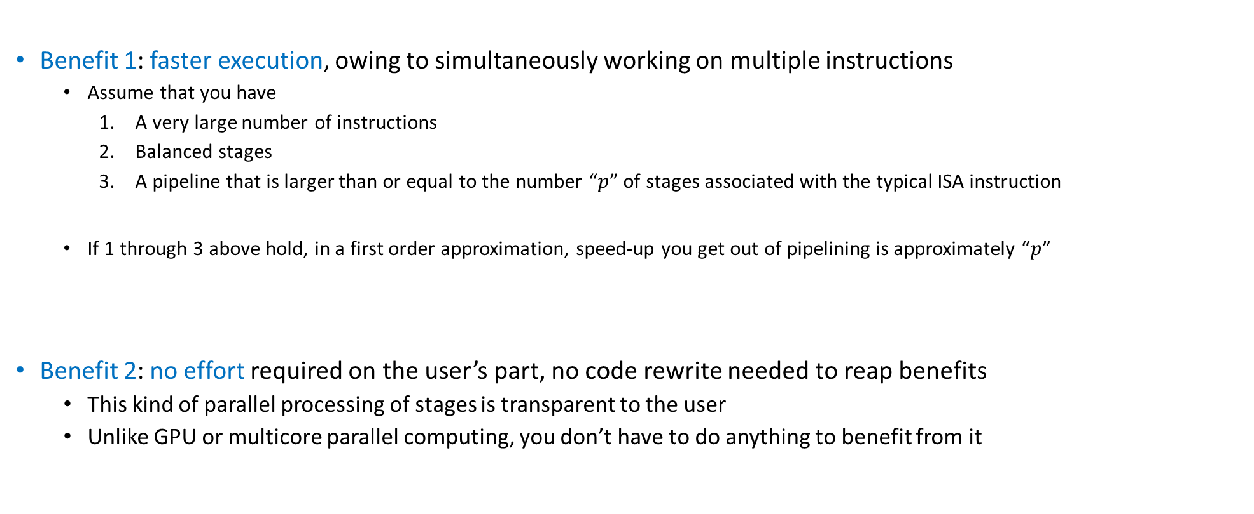
Pipelining Benefits: speed up & no code rewrite
Benefit 1: faster execution, owing to simultaneously working on multiple instructions
Assume that you have
A very large number of instructions
Balanced stages
A pipeline that is larger than or equal to the number “$p$” of stages associated with the typical ISA instruction
If 1 through 3 above hold, in a first order approximation, speed-up you get out of pipelining is approximately “$p$”
Benefit 2: no effort required on the user’s part, no code rewrite needed to reap benefits
This kind of parallel processing of stages is transparent to the user
Unlike GPU or multicore parallel computing, you don’t have to do anything to benefit from it
Notes:
Ideally: at each cycle you complete one instruction
This ignores the need to “prime” the pipeline and to pipeline shutdown.
This ignores hazards (see next)
NOTE: this is not parallel programing, but rather parallel execution (it’s out of the programmer’s hands)

Slide 27
Pipelining, Good to Remember
The amount of time required to complete one stage of the pipeline: one cycle
Pipelined processor: one instruction finished in each cycle
Non-pipelined processor: no overlap when executing instructions
Important Remark:
Pipelining does not decrease the time to complete one instruction but rather it increases the throughput of the processor by overlapping different stages of processing of different instructions
Notes:
NOTE: an individual instruction may take longer to complete (because some stages are delayed to fit the common tick)
The issue here is so-called INSTRUCTION HETEROGENEITY
Ford solved this problem by limiting the number of options:
“Any customer can have a car painted any color that he wants so long as it is black.”
But the benefit is THROUGHPUT

Slide 28
Pipelining Hazards
Q: if deep pipelines are good, why not make them deeper?
A: deep pipelines plagued by pipelining hazards
Structural hazards
Data hazards
Control hazards
[Patterson, 4th edition]→

Slide 29
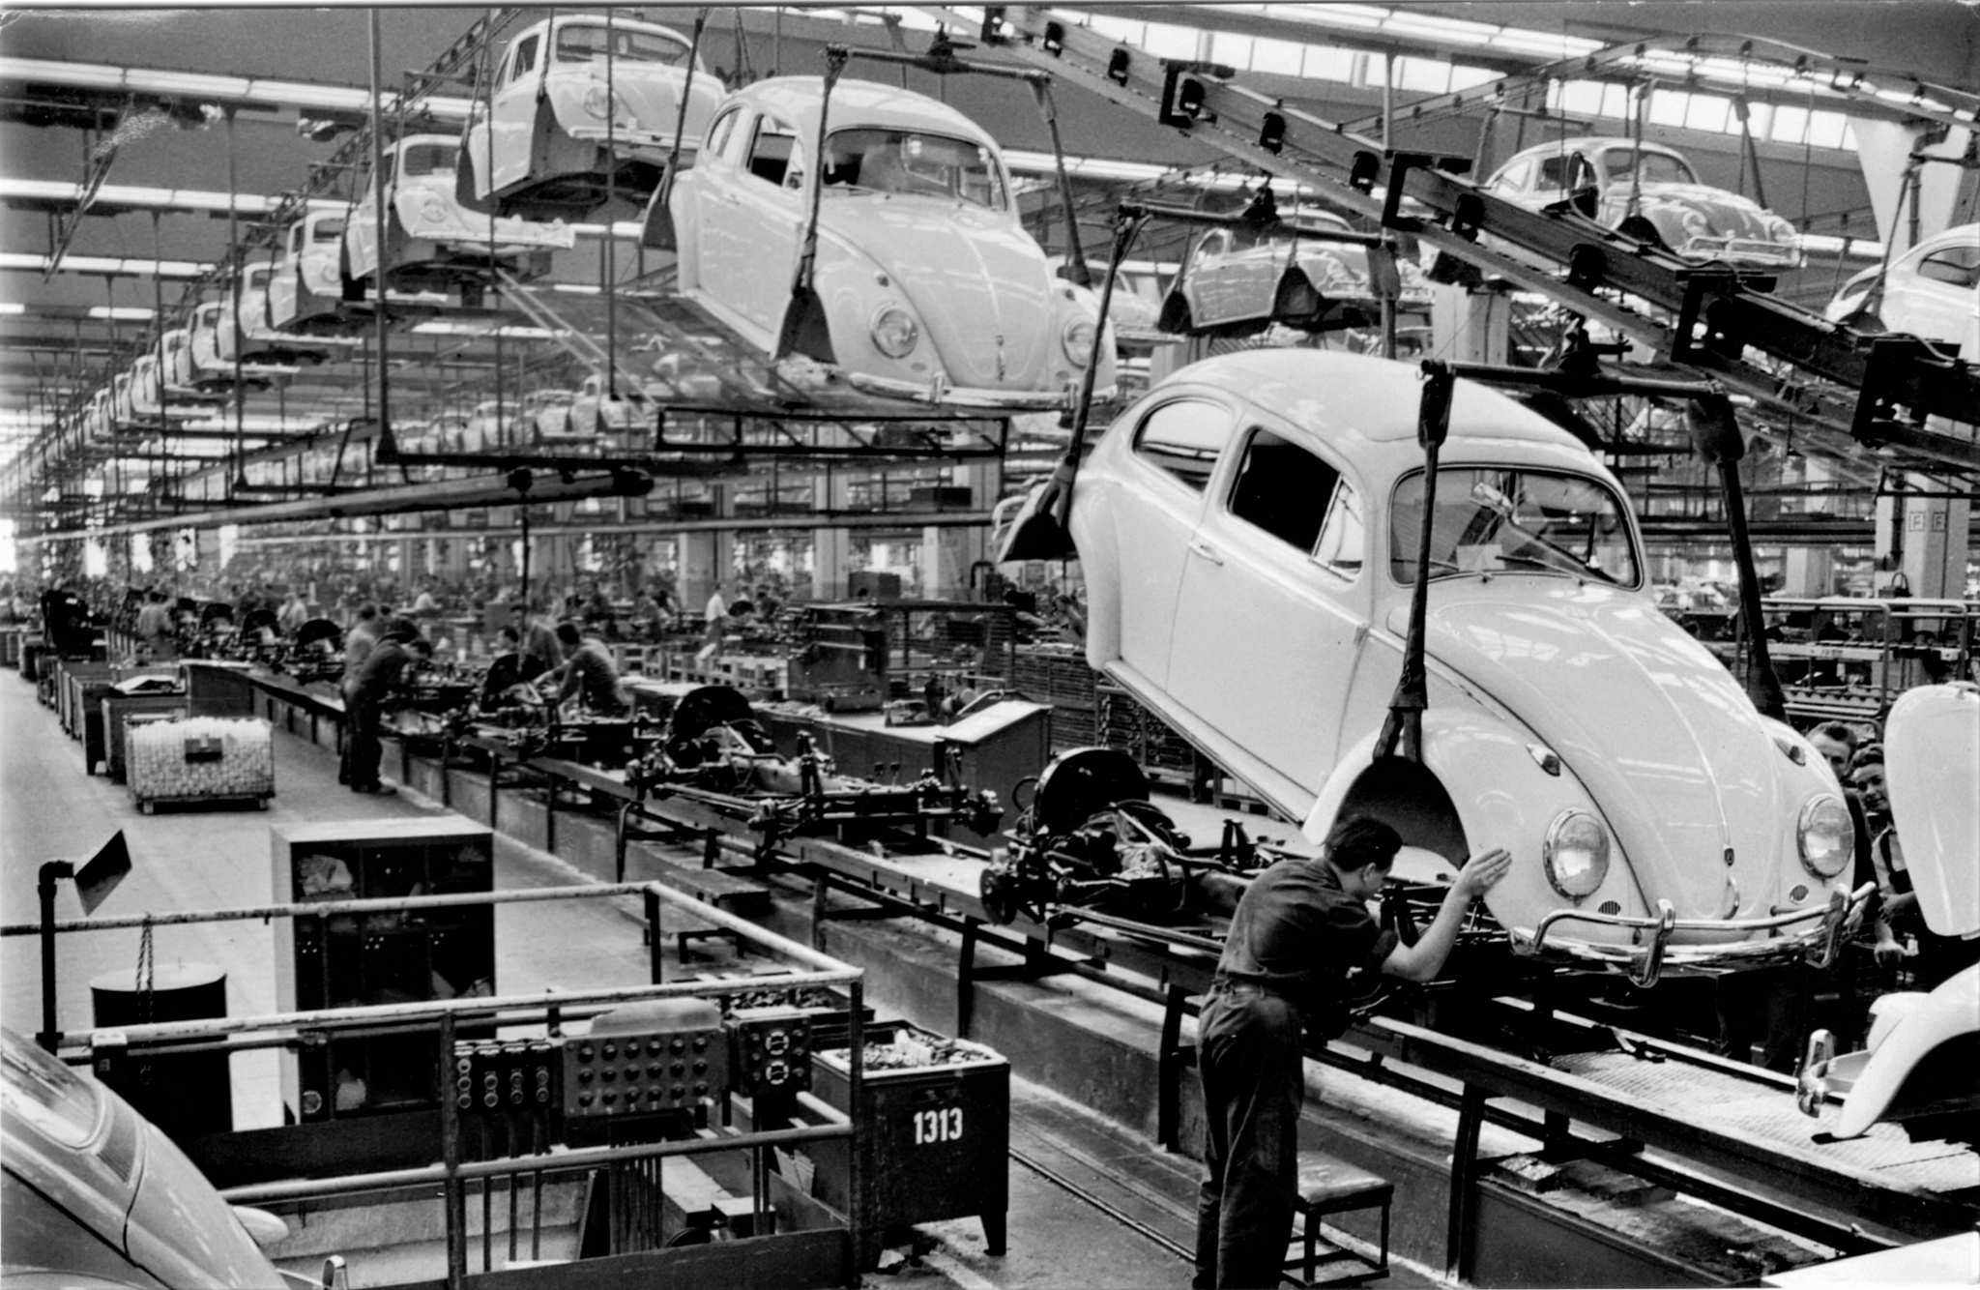
Pipeline Structural Hazards: The problem at hand
A real world assembly line assembles the same product for a period of time
Typically, it can be quickly reconfigured to assemble a different product
The chip processes a broad spectrum of instructions that come one after another
Example: A J-type instruction coming after a R-type instruction, which comes after three I-Type instructions
If they were the same instructions (vehicles), designing a pipeline (assembly line) is straightforward
A structural hazard: the possibility of having a combination of instructions in the pipeline contending for the same piece of hardware
Not encountered when you assembly the same car model (things are “deterministic” in this case)
21,529,464 VW Beetle vehicles produced (1938 until 2003)
[Alden Jewell: https://www.flickr.com/photos/autohistorian/32637661426]$→$
Notes:
CONTENTION for hardware

Slide 30
Pipeline Structural Hazards: Fixing the problem
Possible Scenario: you have a six stage pipeline and the instruction in stage 1 and instruction in stage 5 both need to use the same register to store a temporary variable
Solution 1: there should be enough registers provisioned so that almost any combination of instructions is ok
Solution 2: serialize the access, basically stall the pipeline for a cycle so that there is no contention
Solution 3: Out of order execution (OOOE) done statically (at compile time) or perhaps dynamically (at run time)

Slide 31
Pipeline Structural Hazards: Fixing the problem - comments
Comment, Solution 1:
Adding more registers is a static solution; expensive and consequential (requires a chip design change)
Note that “needing one extra register” is just one possible scenarios; there are might be other contention scenarios lurking
Comment, Solution 2:
Stalling the pipeline at run time is a general solution but slows down the execution
Done by introducing a “bubble” in the pipeline
Comment, Solution 3 (OOOE):
This is a good compromise: it’s general and when you can re-order instructions there is no slowdown

Slide 32
Pipeline Data Hazards (1/2) [very common]
Example, to get the discussion going – Consider assembly below, with a five-stage pipeline chip:
add $t0, $t2, $t4 # $t0 = $t2 + $t4
addi $t3, $t0, 16 # $t3 = $t0 + 16 (“add immediate”)
The first instruction is processed in five stages
Its output (value stored in register $t0) is needed in the very next instruction
Data hazard: unavailability of $t0 to the second instruction, which references this register
Resolution (less than ideal)
Pipeline stalls to wait for the first instruction to fully complete
Notes:
Data DEPENDENCIES
2nd stage of instruction 2 depends on data available only after 5th stage of instruction 1
Sub-optimal solution: introduce “bubbles” in the pipeline

Slide 33
Pipeline Data Hazards (2/2)
add $t0, $t2, $t4 # $t0 = $t2 + $t4
addi $t3, $t0, 16 # $t3 = $t0 + 16 (“add immediate”)
Alternative [the good] Resolution: use “forwarding” or “bypassing”
Key observation: the value that will eventually be placed in $t0 is available after stage 3 of the pipeline (where the ALU actually computes this value)
Provide the means for that value in the ALU to be made available to other stages of the pipeline right away
Avoids stalling - don’t have to wait several cycles before the value made its way into $t0
This process is called “intermediate result forwarding”
Supporting forwarding does not guarantee resolution of all scenarios
Occasionally the pipeline ends up stalled for a couple of cycles
OOOE helps (insert unrelated instruction, wedged between two instructions that depend on each other)

Slide 34
Pipeline Control Hazards (1/2)
What happens when there is an “if” statement in a piece of C code?
A corresponding machine instruction decides the program flow
Specifically, should the “if” branch be taken or not?
Processing this very instruction to figure out next instruction (branch or no-branch) will take a number of cycles
Should the pipeline stall while this instruction is fully processed and the branching decision becomes clear?
If yes: strategy always works, but is slow
If no: rely on branch prediction and proceed fast but cautiously
Notes:
BRANCHING
What is the instruction that should be inserted in the pipeline right after the one that actually decides the branch?

Slide 35
Pipeline Control Hazards (2/2): Branch Prediction
Static Branch Prediction (1st strategy out of two):
Always predict that the branch will not be taken and schedule accordingly
That is, always schedule the “then” branch, never the “else” branch
There are other heuristics for proceeding: for instance, for a do-while construct it makes sense to always be jumping back at the beginning of the loop
Similar heuristics can be produced in other scenarios (a “for” loop, for instance)
Dynamic Branch Prediction (2nd strategy out of two):
At a branching point, the branch/no-branch decision can change during the life of a program based on recent history
In some cases branch prediction accuracy hits 90%
Note: when your prediction is wrong you have to discard the [micro]instruction[s] executed speculatively and take the correct execution path
Notes:
Dynamic branch prediction: requires more hardware to implement the logic (keep track of previous paths)

Slide 36
[New topic]Pipelining vs. Multiple-Issue (1/2)
Multiple-issue: what is that?
In sequential computing, a multiple-issue processor core has the hardware chops to issue more than one instruction per cycle
Pipelining different than “Multiple-Issue,” which is another way of speeding up execution
Example: the C code below leads to a set of instructions that can be launched for execution at the same time
IMPORTANT: No cross-dependency in updating a and c
int a, b;
float c, d;
//some code setting up a, b, c, d
a += b;
c += d;
Notes:
Depart from the “assembly line” analogy. Here, think of a car manufacturing plant where more car models are produced simultaneously, by sharing common available resources (stations).
It’s actually good here to have very different “car models”: it’s less likely to have competition for same resources (stations).

Slide 37
Pipelining vs. Multiple-Issue (2/2)
On average, more than one instruction is processed by the same core in the same clock cycle
Multiple-Issue can be done statically or dynamically
Static multiple-issue:
Predefined, doesn’t change at run time
Who uses it: Intel, in AVX512 (but not only)
Dynamic multiple-issue:
Determined at run time, the chip has dedicated hardware resources that can identify and execute additional work
Who uses it: Intel, AMD, IBM, NVIDIA, etc.
Notes:
Dynamic multiple-issue makes use of a buffer for instructions to be able to look ahead.
We already alluded to other ILP techniques:
out of order execution
speculative execution and branch prediction
also, register renaming, etc.

Slide 38
Pipelining vs. Multiple Issue
(a) Three-stage pipeline
(b) Multiple issue processor
[Modern Operating System, Tanenbaum-Bos]→

Slide 39
Attributes of Dynamic Multiple-Issue
The data dependencies between instruction being processed takes place at run time
Checking for dependencies is complex, requires high cost in time and energy
Checks in place to make sure result is ok
“ok”: no difference if the instructions are executed “multiple-issue” or “single issue”
NOTE: a chip that can do multiple-issue is also called a superscalar architecture
Notes:
CU acts as supervisor to see what instructions can be issued and dispatched simultaneously

Slide 40
The “Instruction-Level Parallelism” (ILP) concept
Pipelining, OOOE, and multiple-issue are presentations of what’s called Instruction-Level Parallelism (ILP)
ILP pursues various strategies to execute simultaneously multiple instructions
Important: these instructions belong to the same program or process; i.e., belong to *one* thread
“process” – how the operating systems calls your program
Notes:
Dynamic multiple-issue makes use of a buffer for instructions to be able to look ahead.
We already alluded to other ILP techniques:
out of order execution
speculative execution and branch prediction
also, register renaming, etc.

Slide 41
ILP: various angles of attack (quick summary of ILP’s bag of tricks)
Instruction pipelining: execution of multiple instructions can be partially overlapped; each instructions divided into sub-steps (termed: micro-operations)
Superscalar execution: multiple execution units are used to execute multiple instructions in parallel
Out-of-order execution: instructions execute in any order but without violating data dependencies
Register renaming: a technique used to avoid data hazards and thus lead to unnecessary serialization of program instructions caused by the reuse of registers
Speculative execution: allows the execution of complete instructions or parts of instructions before being sure whether this execution is required
Branch prediction: used to avoid delays (termed: stalls). Used in combination with speculative execution.
Notes:
Various techniques. Most rely on available extra capacity (hardware/transistors).
For ILP to make a dent, you need large blocks of instructions that can be [attempted to be] run in parallel
Duplicate hardware speculatively executes future instructions before the results of current instructions are known, while providing hardware safeguards to prevent the errors that might be caused by out of order execution
Branches must be “guessed” to decide what instructions to execute simultaneously
If you guessed wrong, you throw away that part of the result
Data dependencies may prevent successive instructions from executing in parallel, even if there are no branches

Slide 42
ILP vs. TLP
ILP not the only show in town
Another flavor of parallelism in use: chip executes simultaneously instructions from different processes
Called Thread-Level Parallelism (TLP)
Both ILP and TLP seek to accomplish the same thing: keep the chip as busy as possible

Slide 43
An example of TLP: Intel’s HTT feature
Typical Intel core supports the “Hyper-Threading Technology” (HTT)
HTT: two threads/processes, each seeing its own stream of machine instructions, active at any given time
“active”: also called “in flight”
The scheduler tries to issue instructions from both processes, at the same time
The CU/ALU hardware up-beefing to support HTT is actually pretty minor
Extra hardware required to save execution state of a thread when idle and not running (for lack of data or available functional units)
[Intel]→
Notes:
Intel HT Technology improves performance through increased instruction level parallelism by having two threads with independent instruction streams, eliminating data dependencies between threads and increasing utilization of the available execution units. This effect typically increases the number of instructions executed in a given amount of time within a core, as shown in Figure 3. The impact of this greater efficiency is experienced by users as higher throughput (since more work gets completed per clock cycle) and higher performance per watt (since fewer idle execution units consume power without contributing to performance). In addition, when one thread has a cache miss, branch mispredict, or any other pipeline stall, the other thread continues processing instructions at nearly the same rate as a single thread running on the core. Intel HT Technology augments other advanced architectural features, higher clock speeds, and additional cores with a capability that is relatively inexpensive in terms of space on the silicon and production cost.

Slide 44
Intel’s HTT Feature
In general, TLP requires the participation of the Operating System (OS)
The OS sees one physical chip as two virtual chips; OS “talks” to both of them
Is HHT helpful?
Yes: when running two modestly demanding applications
Example: Running Chrome and Outlook at the same time
Execution threads are independent, when one execution threads stalls the other can be picked up and advance
No: high performance computing, when one stream of instruction saturates the memory bandwidth
Nothing left for anybody else to step in and nibble on excess-hardware leftover
NOTE: as of recently, the trend has been for TLP to be scaled back owing to security issues
Notes:
Intel HT Technology improves performance through increased instruction level parallelism by having two threads with independent instruction streams, eliminating data dependencies between threads and increasing utilization of the available execution units. This effect typically increases the number of instructions executed in a given amount of time within a core, as shown in Figure 3. The impact of this greater efficiency is experienced by users as higher throughput (since more work gets completed per clock cycle) and higher performance per watt (since fewer idle execution units consume power without contributing to performance). In addition, when one thread has a cache miss, branch mispredict, or any other pipeline stall, the other thread continues processing instructions at nearly the same rate as a single thread running on the core. Intel HT Technology augments other advanced architectural features, higher clock speeds, and additional cores with a capability that is relatively inexpensive in terms of space on the silicon and production cost.

Slide 45
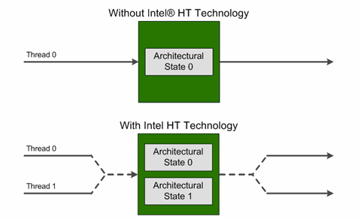
HTT, Intel’s perspective
Highlights:
The processor core maintains two architectural states, each of which can support its own execution thread
Many of the internal microarchitectural hardware resources are shared between the two threads
[Intel]→
Notes:
DAN - Lots of good stuff here: https://software.intel.com/en-us/articles/performance-insights-to-intel-hyper-threading-technology (article by Antonio Valles (Intel))

Slide 46
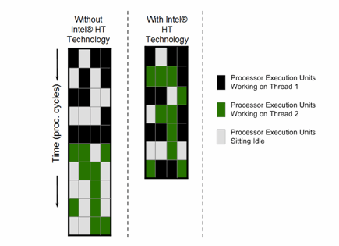
HTT: The Bottom Line
Essentially, one physical core shows up as two virtual cores
Why is it good?
More execution units within the ALU are used at any given time
Higher utilization rate of the hardware assets
When one execution thread stalls (has a cache miss, branch mispredict, pipeline bubble, etc.), the other execution thread continues processing instructions at nearly the same rate as a single thread running on the core
NOTE: HTT is one manifestation of what the industry calls TLP
TLP: Thread-level parallelism
IBM, AMD (Zen micro-architecture) do it too
[Intel]→
Notes:
DAN - Lots of good stuff here: https://software.intel.com/en-us/articles/performance-insights-to-intel-hyper-threading-technology

Slide 47
Superscalar processor or TLP processor? How to figure out.
Superscalar vs. TLP
Superscalar: focus is on one thread (belongs to the Instruction Level Parallelism (ILP) family)
TLP: focus is on multiple threads
“thread”: a sequence of instructions that are a stand-alone part of a program
Superscalar: one thread focus only
HW has the means to execute more than one instruction per cycle
Superscalar: it’s more than a “scalar”; i.e., one thread
TLP: Processor executes more than one instruction; they are issued from different threads
NOTE: we are not talking about multiple-cores; we are still talking about one CPU core here

Slide 48
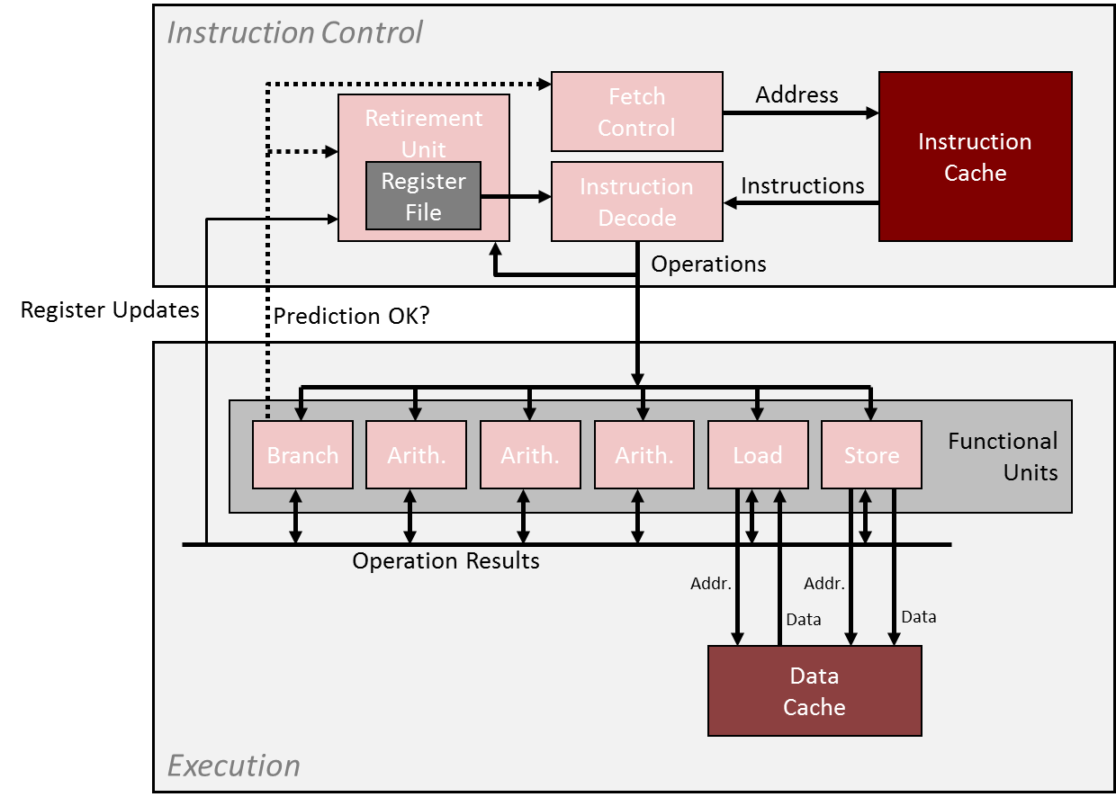
TLP: further discussion
Multi-threading, a possible taxonomy (Hennessey & Paterson)
Coarse grain multi-threading
Fine grain multi-threading
Simultaneous multi-threading
This taxonomy: It all goes back to what goes through this pipe at each clock cycle
The “brain”
The “executioner”

Slide 49
Coarse multi-threading
The Instruction Control issues instructions from one thread for many cycles
Bursts of tens or hundreds of instructions
Instruction Control switches to issuing from another thread only when the first thread runs into a long-latency operation
Examples: cache miss, interrupt, etc.
“long-latency”: Hundreds of cycles or so
!!!!!

Slide 50
Fine multi-threading
Instruction Control can issue instructions from a different thread each cycle
“Barrel-gun style” processing: thread from where next instruction is picked for execution can change at every cycle
GPU computing similar to this
More nimble/sophisticated compared to coarse multi-threading
!!!!!

Slide 51
Simultaneous multi-threading
Simultaneous multi-threading is like fine multi-threading with one caveat:
Instruction Control can issue instructions from different threads in the same cycle
NOTE:
Intel’s HTT is a “simultaneous multi-threading” technology
!!!!!

